Slide 1


Cloud Native Workshop
Cloud Native Architectures and Frameworks

Slide 2
Agenda
Why?
What?
How?

Slide 3
WHY?

Slide 4


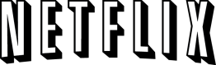


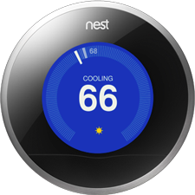
Software is changing industries

Slide 5

CLOUD NATIVE
Agile
Lean
Continuous
Delivery
Microservices
Cloud
DevOps
Notes:
At Pivotal, we really see these trends as manifestations and facets of the same thing – that we call CLOUD NATIVE.
CLOUD NATIVE is the coming together of tools, frameworks and building modern software on a cloud infrastructure

Slide 6
The promise of Cloud Native
Deploy new features daily to production
Automate middleware
Free/Cheap horizontal scaling
Contract between App & Platform that creates Promises.
Datacenter Abstraction – Multi-Cloud
Notes:
That is and should be a governing principle behind any cloud platform, library, or tool. Spring Cloud–an open-source library–makes it easy to develop JVM applications for the cloud. With it, applications can connect to services and discover information about the cloud environment easily in multiple clouds such as Cloud Foundry and Heroku. Further, you can extend it to other cloud platforms and new services.
Application Framework
Spring Cloud : used by Netflix
Spring Boot now over 1M downloads a month, historic levels of growth
Runtime platform
Cloud Foundry elastic runtime used by top FS leaders
Enterprise production ready Linux Container based platform
Infrastructure Automation
CF BOSH: Embedded OS, cloud API integrated
Incredible operational leverage; machine to machine automation

Slide 7
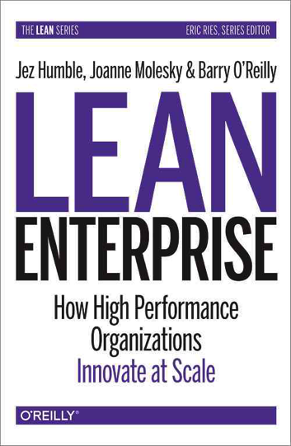
“High performing organizations do not trade off agility for safety.
In fact, high performance is characterized by consistent improvements in levels of both agility and safety.”
Notes:
High performance organizations that innovate at scale do not sacrifice agilty to safety. They invest in improving both. They need a better platform that facilitates that.

Slide 8
WHAT?

Slide 9
Characteristics of Cloud Native Architectures
Continuously Delivered
Twelve Factor Apps (http://12factor.net/)
Microservices
Self-Service agile infrastructure
API-based collaboration
Anti-fragility
Notes:
Continuously Delivered
Twelve Factor Apps (http://12factor.net/)
Microservices
Self-Service agile infrastructure
API-based collaboration
Anti-fragility

Slide 10
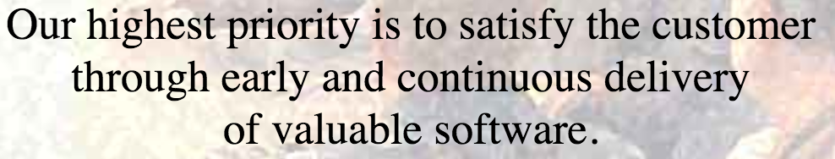
Enabling Continuous Delivery
Development
Operations
Idea
Business
Customer
$
Value
QA
Companies that disrupt, reduce time to value

Slide 11
WaterScrumFall
Production Release
#1
Waterfall Organization
Production Release
#2
Agile Development

Slide 12
Conway’s Law
“Any organization that designs a system (defined broadly) will produce a design whose structure is a copy of the organization's communication structure.”
- Melvin Conway, 1967
http://www.melconway.com/Home/Committees_Paper.html
Notes:
Inverse Conway Maneuver coined by Thoughtworks - http://jonnyleroy.com/2011/02/03/dealing-with-creaky-legacy-platforms/
Goal is to create self contained, business aligned teams with the smallest feedback loop.
Business capability teams interact with platform operations team via APIs and not meetings. This creates a friction free experience for the business capability team who now have the tools to

Slide 13
Inverse Conway Maneuver Enable Continuous Delivery
Product Mgr.
Dev
UX
QA
DBA
Self
Service
APIS
Sys Admin
Network Admin
Storage Admin
Business Capabilities Team Using Microservices
Platform Operations Team
http://jonnyleroy.com/2011/02/03/dealing-with-creaky-legacy-platforms/
http://www.slideshare.net/adriancockcroft/microservices-the-good-bad-and-the-ugly
Notes:
References:
Inverse Conway Maneuver coined by Thoughtworks - http://jonnyleroy.com/2011/02/03/dealing-with-creaky-legacy-platforms/
http://www.slideshare.net/adriancockcroft/microservices-the-good-bad-and-the-ugly
Notes:
Goal is to create self contained, business aligned teams with the smallest feedback loop.
Business capability teams interact with platform operations team via APIs and not meetings. This creates a friction free experience for the business capability team who now have the tools to

Slide 14
Enabling Continuous Delivery
Production Release
ORDERS
Production Release
Production Release
SHIPPING
Production Release

Slide 15
Characteristics of Cloud Native Architectures
Continuously Delivered
Twelve Factor Apps (http://12factor.net/)
Microservices
Self-service, agile infrastructure
API-based collaboration
Anti-fragility
Notes:
Continuously Delivered
Twelve Factor Apps (http://12factor.net/)
Microservices
Self-Service agile infrastructure
API-based collaboration
Anti-fragility

Slide 16
Twelve-Factor Apps
Codebase
Dependencies
Configuration
Backing Services
Build, release, run
Processes
Port binding
Concurrency
Disposability
Dev/prod parity
Logs
Admin processes
APPS
contract
Cloud Platform
Architectural and development practices – http://12factor.net
Notes:
I. Codebase
One codebase tracked in revision control, many deploys
II. Dependencies
Explicitly declare and isolate dependencies (mvn, etc.). Don’t expect servers to have them
III. Config
Store config in the environment. Could you open-source the project w/o revealing secrets?
IV. Backing services
Treat backing services as attached resources. A deploy of the twelve-factor app should be able to swap out a local MySQL database with one managed by a third party (such as Amazon RDS) without any changes to the app’s code
V. Build, release, run
Strictly separate build and run stages. Binary Integrity
VI. Processes
Execute the app as one or more stateless processes
VII. Port binding
Export services via port binding. Routing layer takes care of routes -> ports
VIII. Concurrency
Scale out via the process model
IX. Disposability
Maximize robustness with fast startup and graceful shutdown
X. Dev/prod parity
Keep development, staging, and production as similar as possible
XI. Logs
Treat logs as event streams
XII. Admin processes
Run admin/management tasks as one-off processes

Slide 17
A Brownfield Maturity Model
4. CLOUD NATIVE
Microservice Architecture and Principals
API First Design
Spring Boot, Cloud and Data Flow; product teams and native Microservices (App + Data)
= Agile Enterprise
3. CLOUD RESILIENT
Design for failure
Apps unaffected by dependent service failure
Proactive testing for failure
Metrics and Monitoring baked-in
Cloud Agnostic runtime implementation
12-Factors + Advanced Platform Automation
= Runs Well on Pivotal Cloud Foundry
2. CLOUD FRIENDLY
Adherence with 12-Factor App principals*
Horizontally scalable
Leverage platform for HA
1. CLOUD READY
No file-system requirements or uses S3 API
Self contained app
Platform managed ports and addressing
Consume off platform services using platform semantics
4 to 7 of the Factors = Runs on Pivotal Cloud Foundry
* We believe there are more like 15 “factors” that exemplify a true, “Cloud Native” application… more later

Slide 18
Characteristics of Cloud Native Architectures
Continuously Delivered
Twelve Factor Apps (http://12factor.net/)
Microservices
Self-Service agile infrastructure
API-based collaboration
Anti-fragility
Notes:
Continuously Delivered
Twelve Factor Apps (http://12factor.net/)
Microservices
Self-Service agile infrastructure
API-based collaboration
Anti-fragility

Slide 19
Microservice: Definition
If every service has to be updated in concert, it’s not loosely coupled!
“ Loosely coupled service oriented architecture with bounded contexts"
If you have to know about surrounding services you don’t have a bounded context.
- Adrian Cockcroft

Slide 20
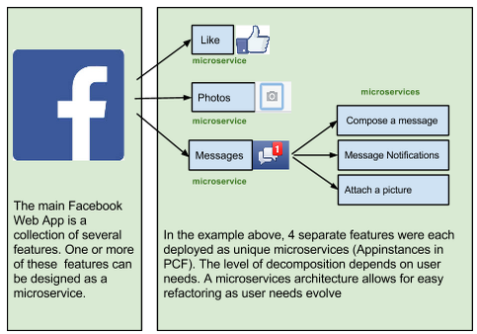
A familiar Microservice example
Notes:
Features can be added, removed, & changed independently, because they’re deployed independently.
Service outages do not affect entire site/app.

Slide 21
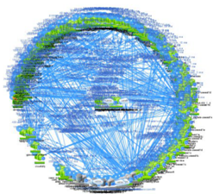
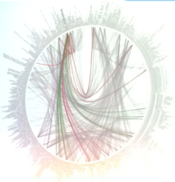

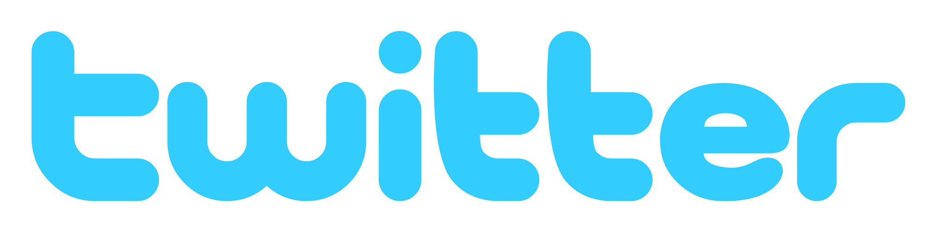
Microservices are hard

Slide 22
Challenges of distributed systems
Configuration Management
Service Registration & Discovery
Routing & Load Balancing
Fault Tolerance (Circuit Breakers)
Monitoring
Concurrent API Aggregation & Transformation
Notes:
Everybody faces these, SpringCCloudServices takes PCF to the next level

Slide 23
HOW?

Slide 24
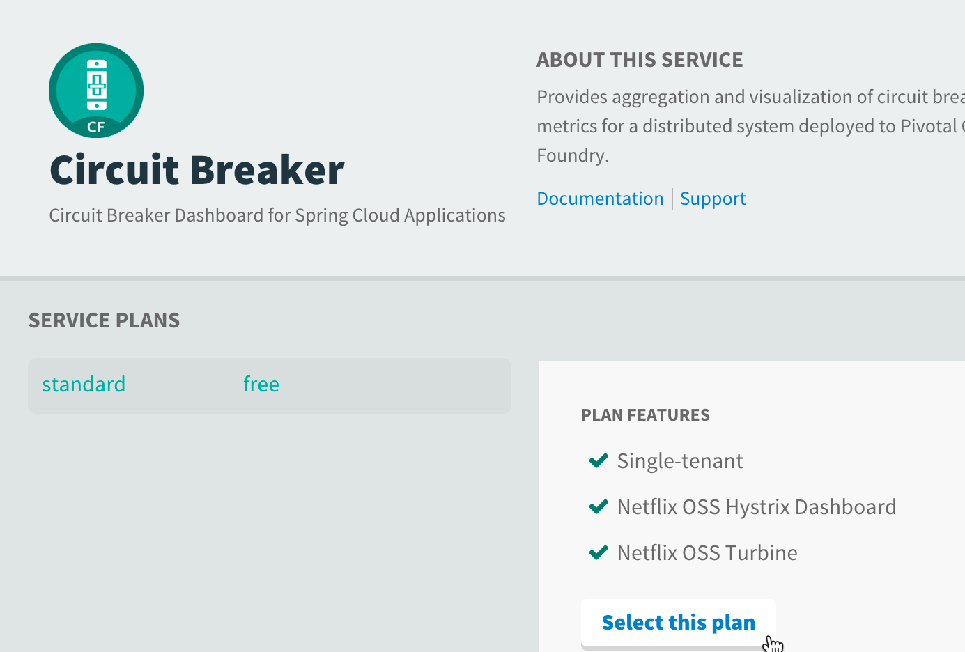
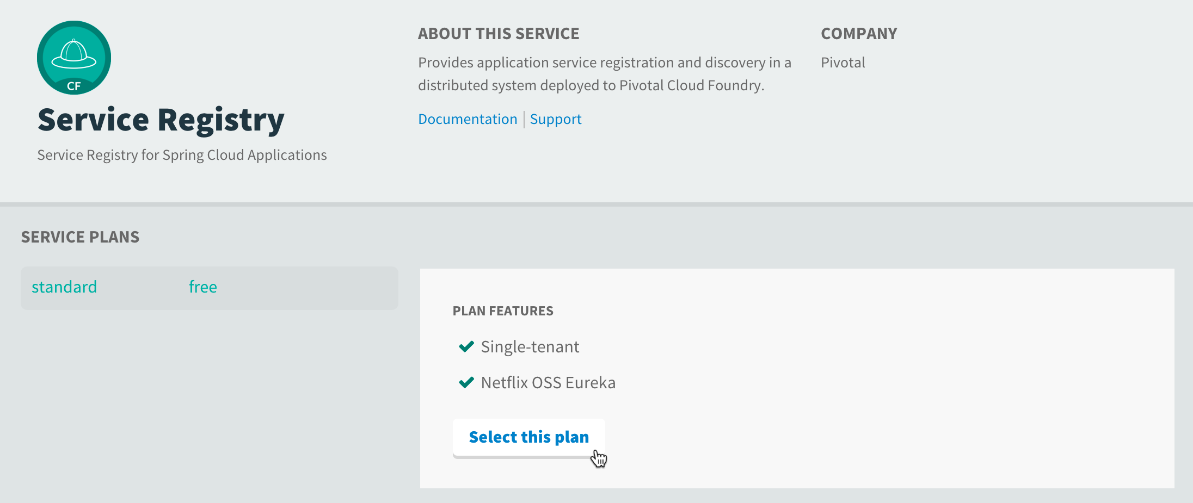

It takes a Cloud Native
Application Framework
Runtimes and their client libraries for:
Configuration Management
Service Discovery
Routing & Load Balancing
Circuit Breakers
Reverse Proxies
….and much more
Security (encrypt, SSO, roles)
Connectors for CF, Heroku, AWS

Slide 25
And a Cloud Native Platform
An end-to-end platform that makes implementing distributed application best practices, a turn-key and first practice

Slide 26

Essential elements of a Cloud-Native Platform
Rapid Provisioning of infrastructure components
Rapid Application Deployment & Management
Scales Horizontally
Basic Monitoring, Logs & Metrics
No-downtime platform upgrades
Dynamic load balancing and routing
Manage supporting services (data, messaging)
Failure detection and health remediation
Notes:
Cloud native applications are an evolution of software development and deployment that embraces DevOps and containers and breaks applications down to smaller individual components. Organizations can develop and deploy faster because there is a modular approach that makes code more efficient and enables much of the common or routine elements to be automated.
There are a variety of “moving parts” involved in doing microservices successfully. Your organization should adopt a DevOps culture and have the appropriate infrastructure in place to avoid getting it wrong. Microservices architecture is generally built on a foundation of cloud and virtualization, and relies heavily on automation to ensure success and avoid failures.

Slide 27
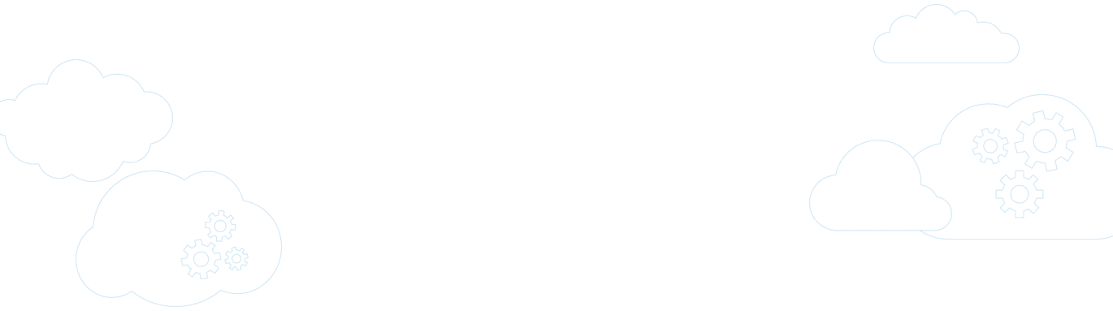

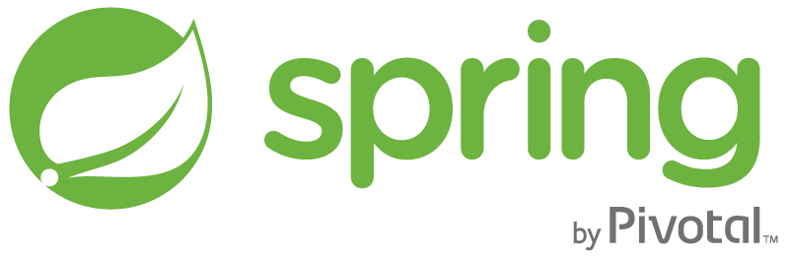
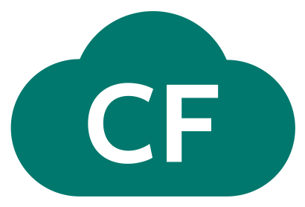
Pivotal Cloud Foundry
A complete framework for delivering software rapidly, consistently and reliably at scale.
Language frameworks designed for microservice architectures with components for service discovery, metrics, circuit breakers and more.
Application Framework
Application container runtime with production-ready backing services, automated build pipeline, routing, health management and logging.
Platform Runtime
Pivotal
Cloud Foundry
API-based infrastructure provisioning that delivers bit-for-bit, consistent, self-healing deployments across private and public cloud.
Infrastructure Automation
Pivotal
Cloud Foundry
Notes:
PCF is the 1st and only cloud native vendor available today

Slide 28


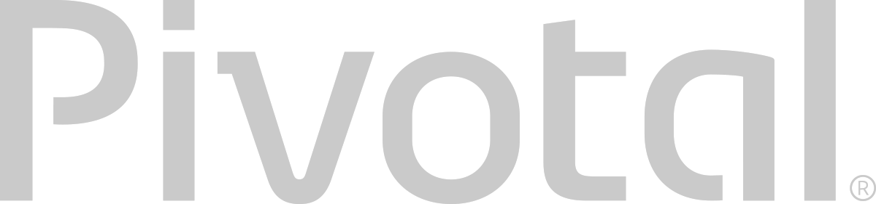
Cloud Foundry Haiku
Here is my source code
Run it on the cloud for me
I do not care how

Slide 29
Bosh Haiku
Here are my servers
Go make them a cloud foundry
I do not care how

